Slide 1
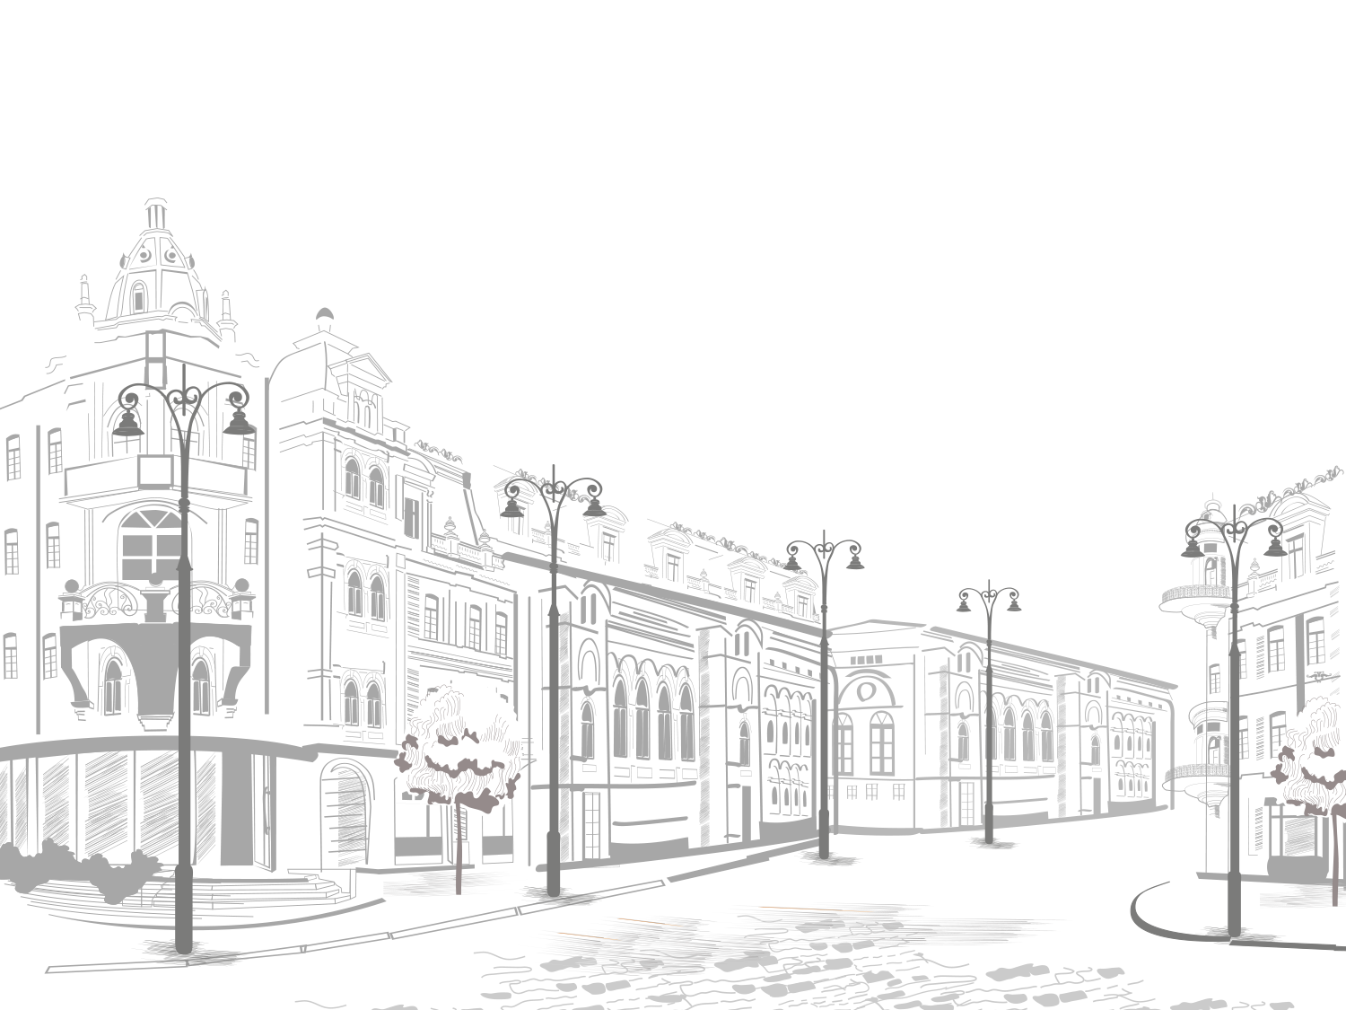
Travelling

Slide 2
Lesson objectives
extend understanding of lexis connected to the topic
practice speaking using notes
say what you think about the different types of transport
use new vocabulary in the speech.

Slide 3
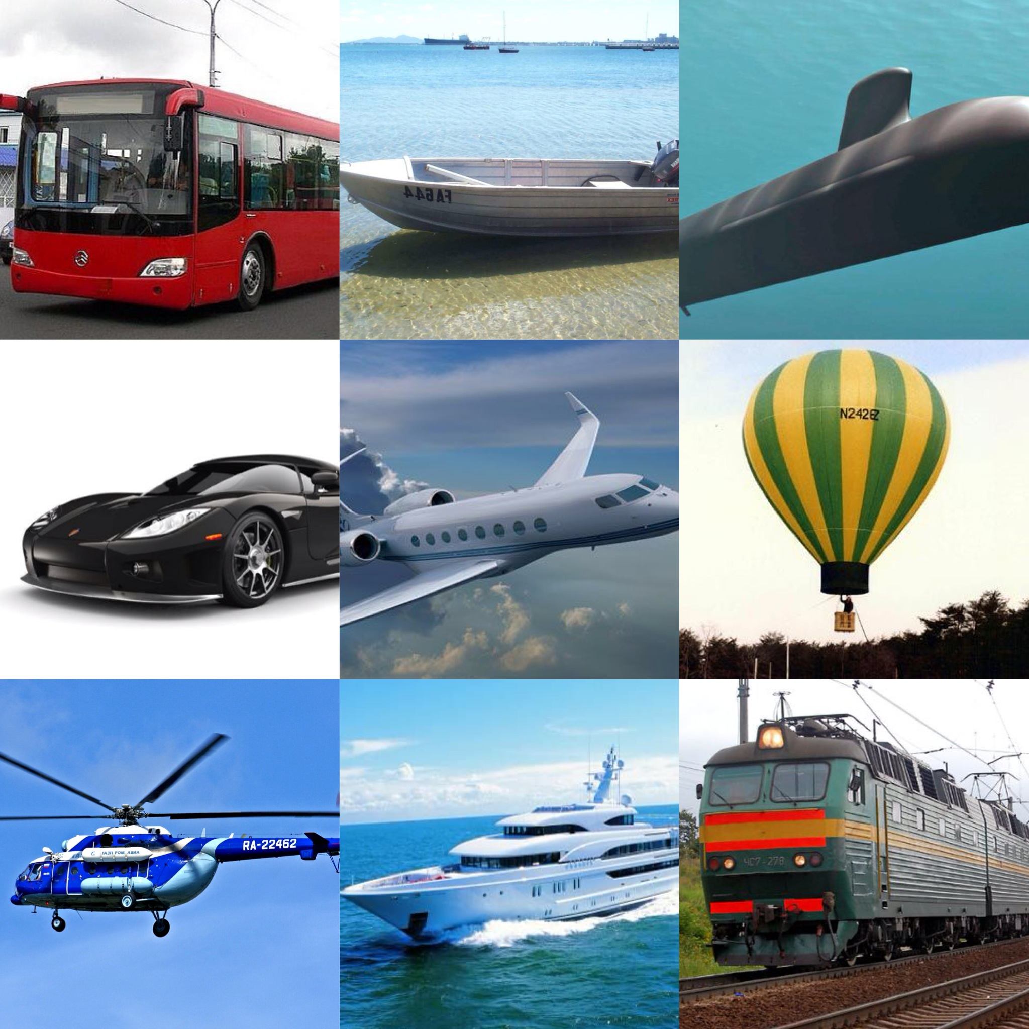
Categorize the transport

Slide 4
Give the words to the definitions:
1 | …means to move from place to place, usually over а long distances
2 | … is a holiday during which you travel on a ship or boat and visit a number of places en route.
3 | …is the motion of an object in or through a medium, especially through the earth’s atmosphere.
4 | …is a journey during which several places are visited, especially on a holiday.
5 | …is a journey on a bus.
6 | …is an official document issued by a government identifying a citizen, his or her nationality, and formally requesting admittance and safe passage from foreign countries.
7 | …is a very long trip, usually at sea.
8 | …describes the whole process of going somewhere and coming back (more than 1 journey).
9 | …is a small house or cottage, usually of simple design and construction.
10 | …means moving from one place to another, especially in a vehicle. It is a single piece of travel.
11 | …is a comfortable bus.
12 | …is a tour arranged by a travel agent.

Slide 5

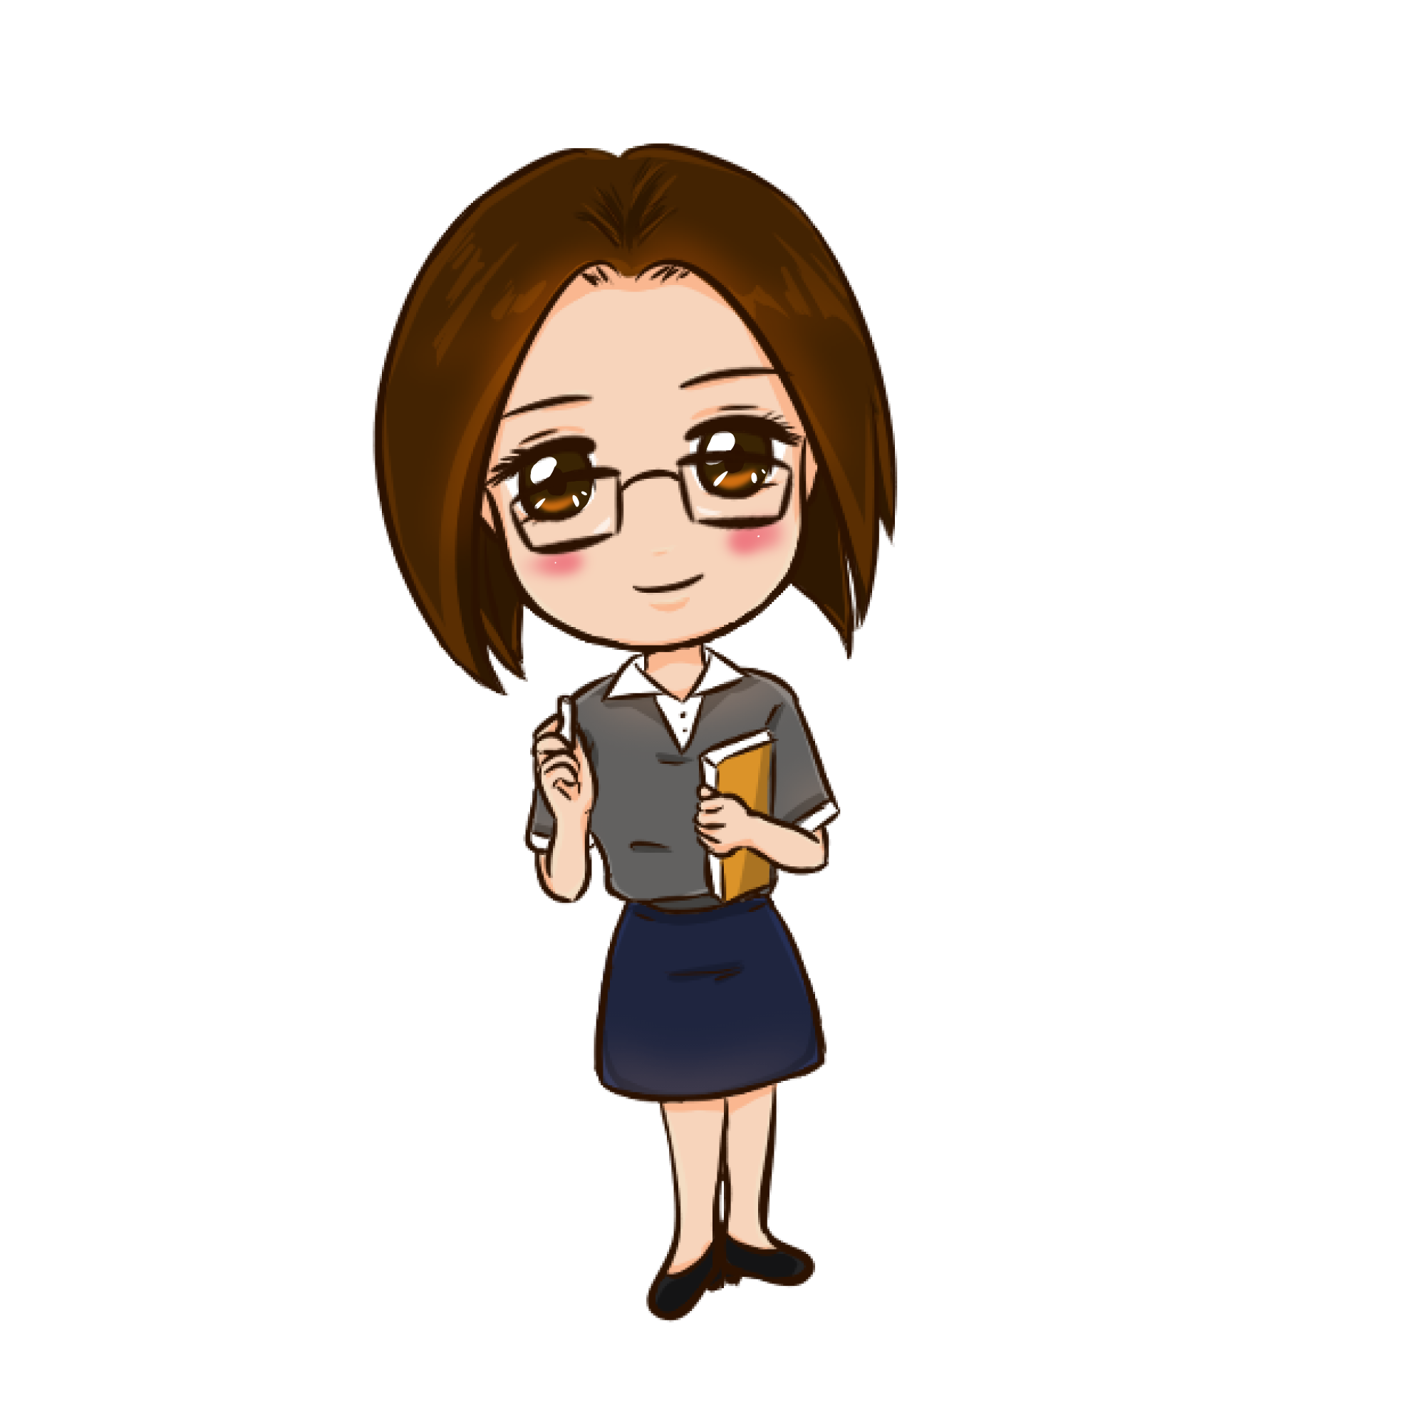
Keys
1 | Travel
2 | Journey
3 | Trip
4 | Voyage
5 | A bus ride
6 | Passport
7 | Cruise
8 | Flight
9 | Cabin
10 | A bus ride
11 | A сoach
12 | Package holiday

Slide 6
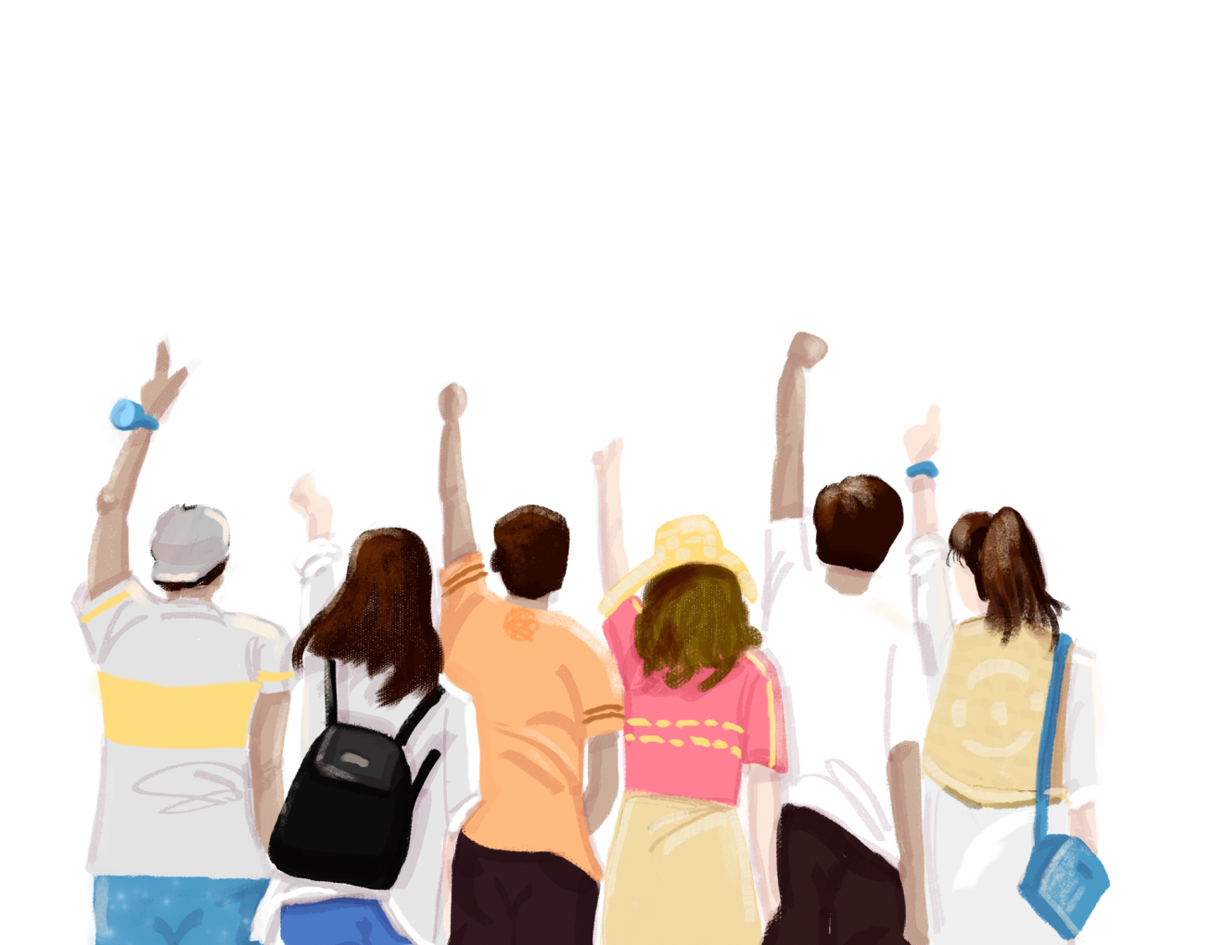
Dialogue/ Role play
Speak from 1 to 2 minutes - 1 point
Use accurate grammar (no more than 2 mistakes)
- 1 point
Use topical vocabulary(travel and transport) - 1 point
Group members’ artistic skills - 1 point
Use only English – 1 point
Total: 5 points

Slide 7

Success criteria
Speak from 1 to 2 minutes-1 point
Use accurate grammar
(no more than 2 mistakes) -1 point
Use topical vocabulary
(travel and transport) -1 point
Group members must work together-1 point
Use only English - 1point
Total:5 points

Slide 8


Feedback
What emotions do you feel, when you are travelling?
Why?
Positive
Emotions
Negative
Emotions
satisfaction happiness
joy
admiration
proud surprise
unsatisfaction
irritation
boredom sadness
anxiety fear

Slide 9
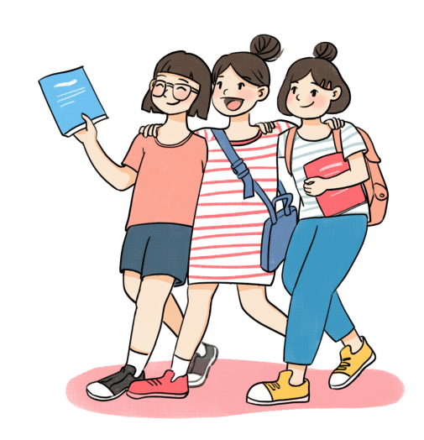

Hey, guys,
we are going to Tula!

Slide 10
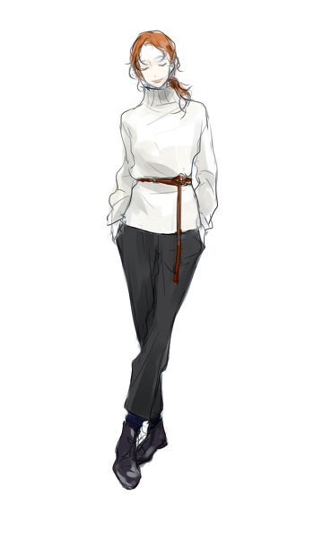
Many masters lived In Tula
What do you know
about these men?
What do you know
about Tula?
Give me some facts
about that city

Slide 11
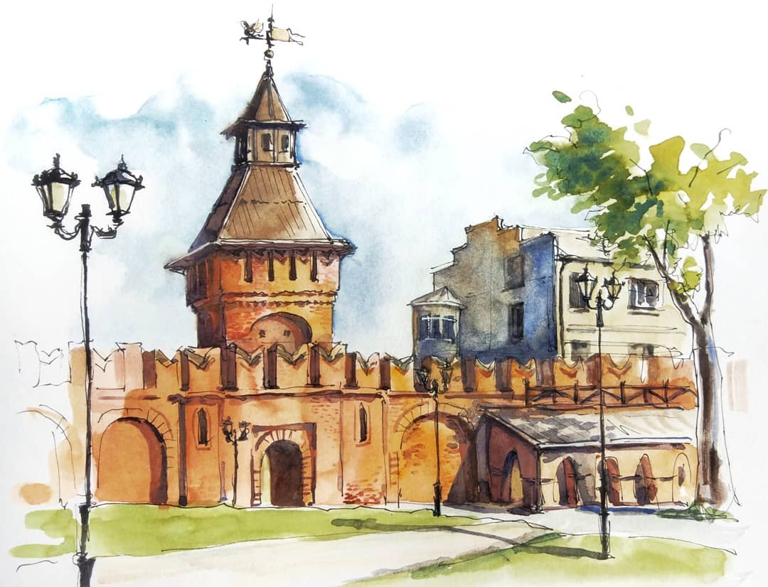

Slide 12
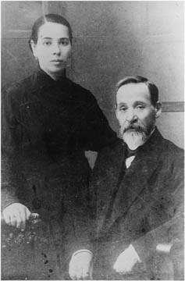
This is Vasiliy Serikov
He created the oldest Tula’s factory of gingerbread
Слово «пряник» дословно
не переведешь
Cake – торт, пирожное,
кекс, пряник
honey-cake – медовый пирог, пряник
gingerbread – имбирный пряник

Slide 13
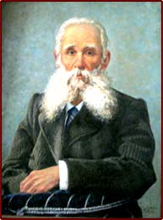
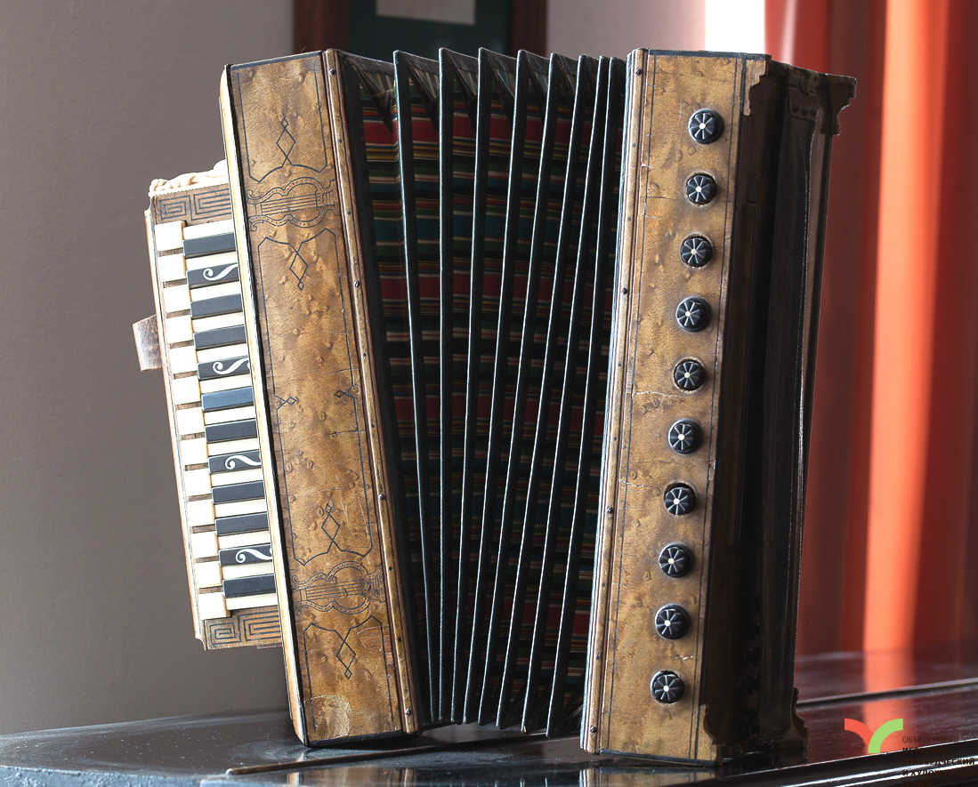
This is Nikolay Beloborodov
He created the russian musical instrument
– the harmonics

Slide 14
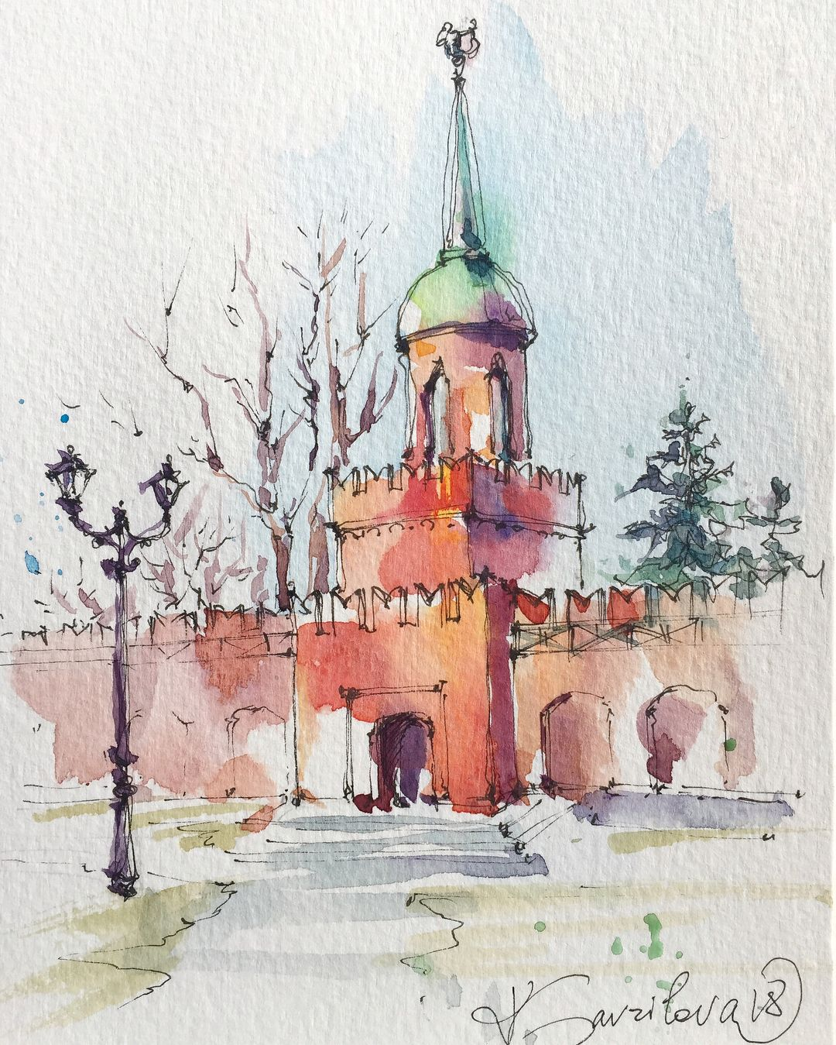
What do
you know
about the Tula’s Kreml?

Slide 15
Travelling

